Slide 1
Vm Scaleset

Slide 2

What is VM?
A virtual machine is an application that emulates a whole computer and runs inside your physical computer. It works as a separate independent machine, but it runs as a process on your host operating system. It's a convenient way to dedicate a portion of your computer resources to a specific task or software.

Slide 3
What are Virtual Machine Scale Sets?
Azure Compute which helps to provide high availability and better performance to your application by creating & managing a group of identical, load balanced VMs
The number of VMs can automatically increase or decrease in response to demand or on a defined schedule
Supports up to 1000 VMs, with your own custom images up to 600 VMs

Slide 4
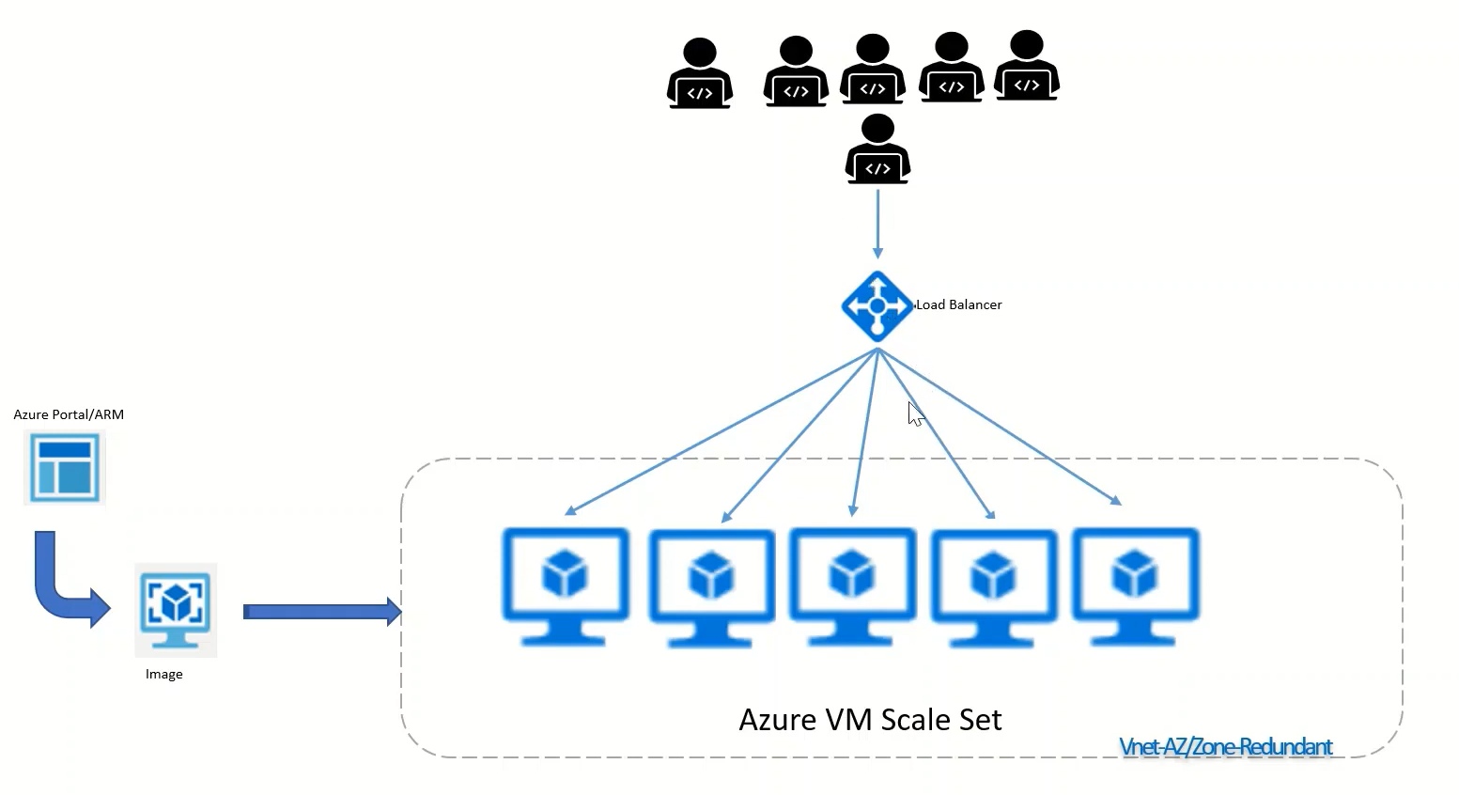
Azure Scaleset Custom Image
Image : An image contains a boot loader, an operating system, and a root file system that is necessary for starting an instance.
Load Balancer : Load balancing refers to evenly distributing load (incoming network traffic) across a group of backend resources or servers.
Initially 3 instances will be started by scaleset. Later it will increase by the scaleset for the user need.

Slide 5
Types of Scaling in VMSS
Manual Scaling : You can manually increase or decrease the number of vm instances in the scale set based on demand.
Automatic Scaling : VMSS provides automayic scaling options that allow you to scale the number of VMs based on demand, time-based schedules, or custom metrics.

Slide 6
Why use Virtual Machine Scale Sets?
To provide redundancy and improved performance, applications are typically distributed across multiple instances. Customers may access your application through a load balancer that distributes requests to one of the application instances. If you need to perform maintenance or update an application instance, your customers must be distributed to another available application instance. To keep up with extra customer demand, you may need to increase the number of application instances that run your application.

Slide 7
Easy to create and manage multiple VMs
Provides high availability and application resiliency
Allows your application to automatically scale as resource demand changes
Works at large-scale

